Slide 1
SCRUM WEBINAR
Saurabh Kandhway

Slide 2
What is agile methodology
An agile methodology is an iterative approach to software development. Each iteration of agile methodology takes a short time interval of 1 to 4 weeks. The agile development process is aligned to deliver the changing business requirement. It distributes the software with faster and fewer changes.
The single-phase software development takes 6 to 18 months. In single-phase development, all the requirement gathering and risks management factors are predicted initially.
The agile software development process frequently takes the feedback of workable product. The workable product is delivered within 1 to 4 weeks of iteration.

Slide 3
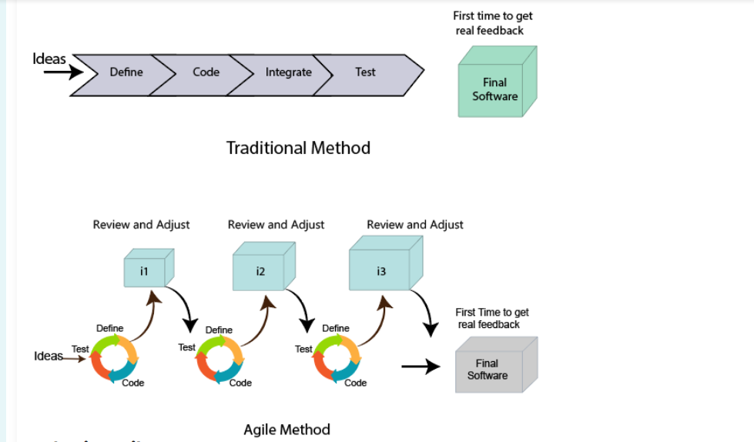
Agile lifecycle

Slide 4
Roles in agile
Scrum Master
The Scrum Master is a team leader and facility provider who helps the team member to follow agile practices, so that the team member meets their commitments and customers requirements. The scrum master plays the following responsibilities:
They enable the close co-operation between all the roles and functions.
They remove all the blocks which occur.
They safeguard the team from any disturbances.
They work with the organization to track the progress and processes of the company.

Slide 5
Roles in agile
Product Owner
The Product Owner is one who runs the product from a business perspective. The Product Owner plays the following responsibilities:
He defines the requirements and prioritizes their values.
He sets the release date and contents.
He takes an active role in iteration and releasing planning meetings.
He ensures that the team is working on the most valued requirement.
He represents the voice of the customer.
He accepts the user stories that meet the definition of done and defined acceptance criteria.

Slide 6
Roles in agile
Cross Functional Team
Every agile team contains self-sufficient team with 5 to 9 team members. The average experience of each member ranges from 6 to 10 years. The agile team contains 3 to 4 developers, 1 tester, 1 technical lead, 1 scrum master and 1 product owner.
The Scrum master and Product owner are considered as a part of Team Interface, on the other hand remaining members are the part of Technical Interface.

Slide 7
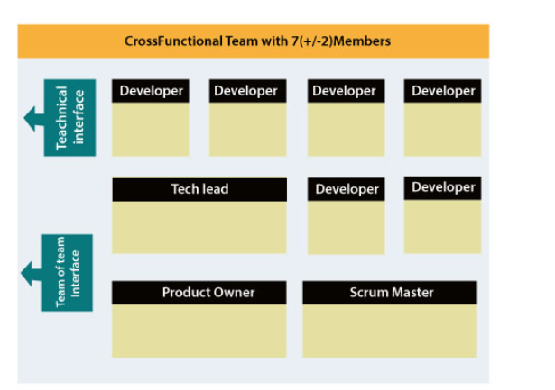
Cross functional team composition

Slide 8
How an agile team plan their work
An Agile methodology is not a specific set of ceremonies or specific development techniques. Rather, it is a group of methodologies that demonstrate a commitment to tight feedback cycles and continuous improvement. An Agile team works in iterations to deliver the customer requirement, and each iteration takes 10 to 15 days. However, the original Agile Manifesto didn't set the time period of two-week iterations or an ideal team size.
Each user requirement is a planned based and their backlog prioritization and size. The team decides, how much scope they have and how many hours available with each team to perform their planed task.

Slide 9
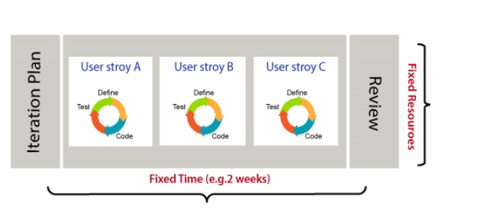
Agile planning architecture

Slide 10
User requirement
The user requirement defines the requirements of the user in terms of functionalities. There may be of two type of functionality.
As a <User Role> I want <Functionality> so that <Business Value>
In order to <Business value> as a <User Role> I want <Functionality>.
During software release planning, a rough estimate is given to a user requirement using relative scale points. During iteration planning, the requirement is broken down into tasks.

Slide 11
Relation between user requirement and task
User requirement talks about what is to be done. It defines the needs of users.
Task talks about how it is to be done. It defines how functionality is implemented.
User requirements are implemented by tasks. Every requirement is gathering as the task.
User requirement is divided into different tasks when it is planned in current iteration.
User tasks are estimated in hours based, generally it is between 2 to 12 hours.
Requirements are validated using acceptance test.

Slide 12
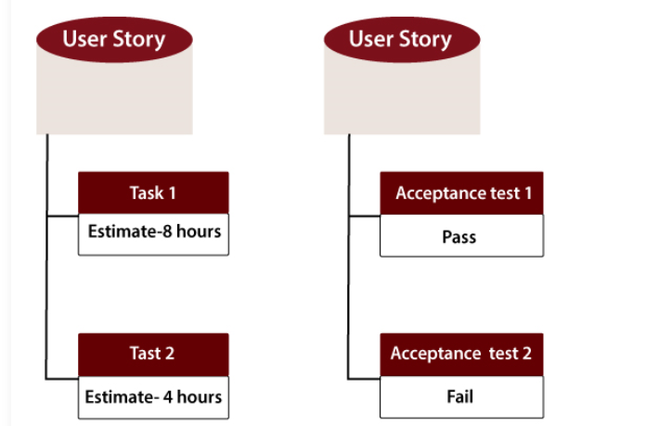
Relation between user requirement and task

Slide 13
Software acceptance criteria
Acceptance Criteria is defined as the functionality, behavior, and performance required by a product owner. It defines what is to be done so that the developer knows when a user requirement is complete.
The Agile team decides the meaning of task done. There may be different criteria for it:
When the entire task (development, testing) are completed.
When all the acceptance tests are running and are passed.
When no defects found.
Product owner has accepted the requirement.
When the software product is delivered to the end user.

Slide 14
Agile manifesto
There are 12 principles of agile manifesto
Customer Satisfaction: Manifesto provides high priority to satisfy the costumer's requirements. This is done through early and continuous delivery of valuable software.
Welcome Change: Making changes during software development is common and inevitable. Every changing requirement should be welcome, even in the late development phase. Agile process works to increase the customers' competitive advantage.
Deliver the Working Software: Deliver the working software frequently, ranging from a few weeks to a few months with considering the shortest time period.
Collaboration: Business people (Scrum Master and Project Owner) and developers must work together during the entire life of a project development phase.
Motivation: Projects should be build around motivated team members. Provide such environment that supports individual team members and trust them. It makes them feel responsible for getting the job done thoroughly.
Face-to-face Conversation: Face-to-face conversation between Scrum Master and development team and between the Scrum Master and customers for the most efficient and effective method of conveying information to and within a development team.

Slide 15
Agile manifesto
Measure the Progress as per the Working Software: The working software is the key and primary measure of the progress.
Maintain Constant Pace: The aim of agile development is sustainable development. All the businesses and users should be able to maintain a constant pace with the project.
Monitoring: Pay regular attention to technical excellence and good design to maximize agility.
Simplicity: Keep things simple and use simple terms to measure the work that is not completed.
Self-organized Teams: The Agile team should be self-organized. They should not be depending heavily on other teams because the best architectures, requirements, and designs emerge from self-organized teams.
Review the Work Regularly: The work should be reviewed at regular intervals, so that the team canreflect on how to become more productive and adjust its behavior accordingly.

Slide 16
Agile characteristics
Agile Development Releases and Fixed-Length Iterations
Agile Development Delivers-Working, Tested Software
Value-Driven Development
Continuous (Adaptive) Planning
Multi-Level Planning in Agile Development
Relative Estimation
Continuous Testing
Continuous Improvement

Slide 17
What is scrum
Scrum is a framework within which people can address complex adaptive problems, while productively and creatively delivering products of the highest possible value.
The Scrum framework consists of Scrum Teams and their associated roles, events, artifacts, and rules. Each component within the framework serves a specific purpose and is essential to Scrum’s success and usage.
Scrum is not a process or a technique for building products; rather, it is a framework within which you can employ various processes and techniques. Scrum makes clear the relative efficacy of your product management and development practices so that you can improve.

Slide 18
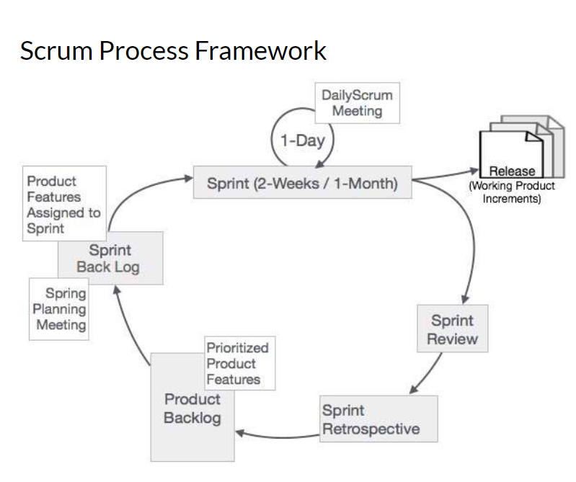
Scrum process framework

Slide 19
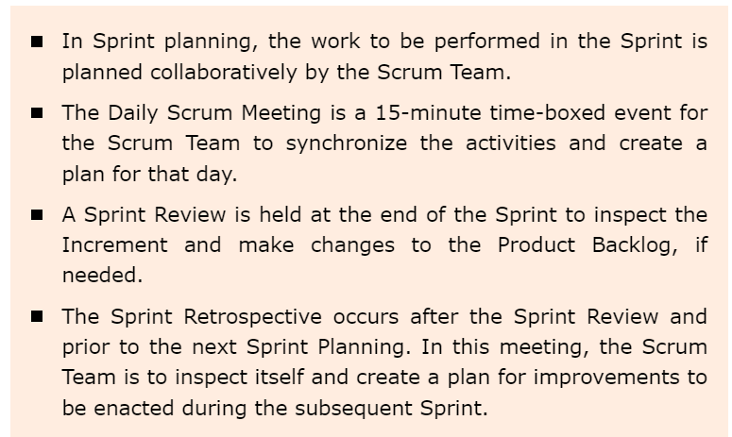
What is sprint
The heart of Scrum is a Sprint, a time-box of two weeks or one month during which a potentially releasable product increment is created. A new Sprint starts immediately after the conclusion of the previous Sprint. Sprints consist of the Sprint planning, daily scrums, the development work, the Sprint review, and the Sprint retrospective.

Slide 20
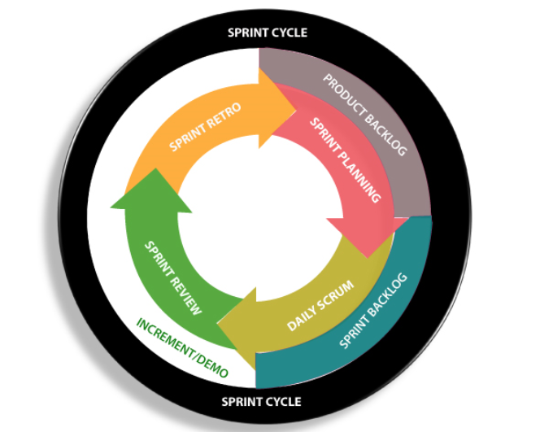
Sprint cycle
Sprints are a short, time-boxed period for Scrum team that works to complete a set amount of work. Sprints are the core component of Scrum and agile methodology. The right sprints will help our agile team to ship better software.

Slide 21
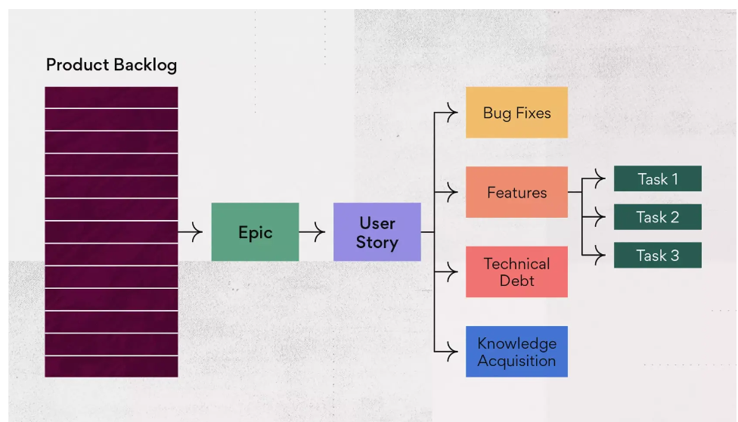
Product backlog
A product backlog commonly includes features, bug fixes, technical debts, and knowledge acquisition. These product backlog items are distinct pieces of work that have yet to be delivered for a product.

Slide 22
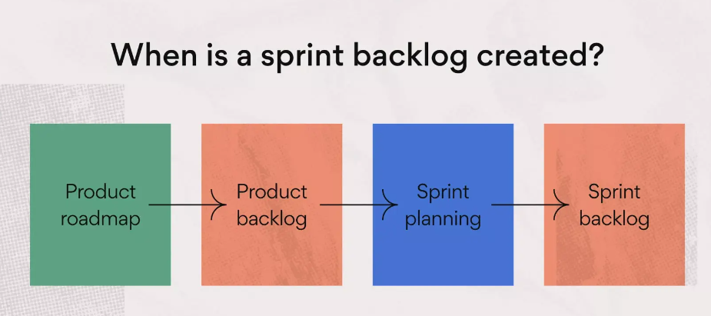
Sprint backlog
A sprint backlog is a list of work items your team plans to complete during a project sprint. These items are usually pulled from the product backlog during the sprint planning session. A clear sprint backlog prevents scope creep by clarifying exactly what your team will be doing—and not doing—during each sprint.

Slide 23
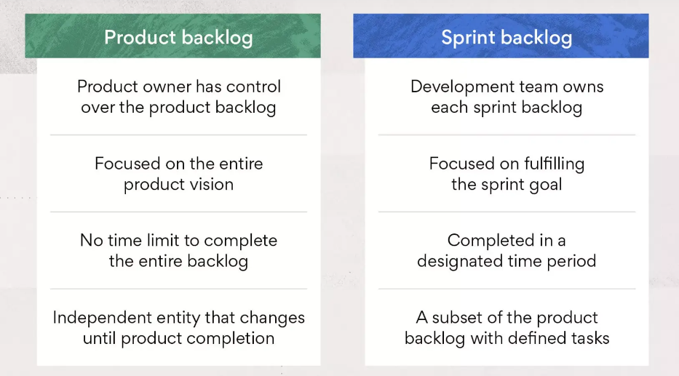
Sprint backlog vs product backlog

Slide 24
Sprint planning
Sprint plan is an action in Scrum that kicks off the sprint. The primary purpose of sprint plan is to define what can deliver in the sprint. It also focuses on how the work will be achieved. It is done in combination with the whole Scrum team members.
The sprint is a set of the period where all the work to be done. Before we start the development, we have to set up the sprint. We need to describe how long time is required to achieve the sprint goal and where we are going to start.

Slide 25
factors affecting sprint planning
The What: The product owner describes the goal of the sprint and the backlog items which contribute to achieve that goal.
The How: Agile development team plans its necessary work on how to achieve and deliver the sprint goal.
The Who: The product owner defines the goal based on the value that the customers seek. And the developer needs to understand how they can or cannot deliver that goal.
The Inputs: The product backlog provides the list of input stuff that could potentially be part of the current sprint. The team looks over the existing work done in incremental ways.
The Outputs: The critical outcome of sprint planning is to meet described team goal. The product set the goal of sprint and how they will start working towards the goal.

Slide 26
Sprint planning process
Who Attends Sprint Planning?
Sprint planning involves the entire Scrum team: the development team, Product Owner, and Scrum Master.
How Long Should Sprint Planning Last?
Sprint planning is limited to a maximum of eight hours.
The general rule of thumb is to allow two hours of sprint planning for every one week of sprint length. That means teams should timebox sprint planning to four hours for a two-week sprint and eight hours for a one-month sprint.

Slide 27
Daily scrum call
The daily scrum is a 15-minute Scrum meeting held on on each day of a sprint. (You might also have heard it called a daily standup or daily stand up meeting). The purpose of the daily scrum is for the team to inspect and adapt its progress.
Daily scrums are typically held in the same location and at the same time each day. Ideally, a daily scrum meeting is held in the morning, as it helps set the context for the coming day's work.
Daily Scrum call goal
The daily scrum meeting is used to inspect and adapt progress in a sprint. It is an opportunity for the team to inspect how it is progressing on the work of the sprint, and adapt as necessary to complete that work. The daily scrum is also the event where impediments to the sprint goal are shared

Slide 28
Sprint review
Sprint reviews focus on the product being developed, specifically on the potentially shippable product increment created during the sprint. During a sprint review, the scrum team invites stakeholders to discuss what was completed during the sprint. They adapt the product backlog as needed based on this feedback. The product owner has the option to release any of the completed functionality.
How often are sprint reviews conducted or held?
The sprint review frequency depends on the below criteria:
The number of sprints that the team typically requires to deliver a product prototype.
The average length of each sprint within that particular project.

Slide 29
When and who
Who Attends a Sprint Review?
The entire scrum team attends the sprint review. The team invites users, customers, stakeholders, senior managers, and affected departments (e.g., marketing, customer support) to attend and give feedback. Scrum teams are encouraged to invite as many people as the room can hold--diverse feedback is essential for creating excellent products.
How Long Should Sprint Reviews Last?
Sprint reviews are limited to a maximum of four hours.
The general rule of thumb is to allow one hour for sprint review every one week of sprint length. That means teams should timebox sprint review to two hours for a two-week sprint and four hours for a one-month sprint.

Slide 30
Sprint retrospective
A retrospective is a meeting where a team examines how it’s working together with the goal of improving their future collaborations. You might also hear retrospective meetings referred to as Scrum retrospectives, sprint retrospectives, or even post-mortems. Agile teams perform retrospectives at the end of sprints – which are short periods of time (or timeboxes) in which teams complete a set amount of work.
What Happens in a Sprint Retrospective?
Sprint retrospectives focus on the process. During a sprint retrospective, the scrum team discusses what went right and areas for improvement in the sprint. They make tangible plans for how to improve their own process, tools and relationships.

Slide 31
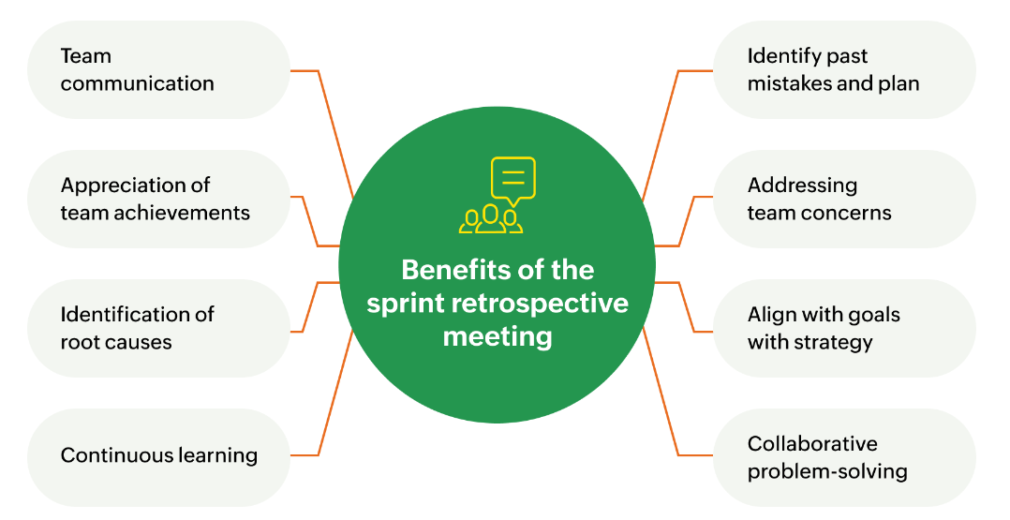
Sprint retrospective continued
Sprint retrospectives are limited to a maximum of three hours.
The general guidance is to allow 45 minutes for each week of sprint length. So a two-week sprint would cap the sprint retrospective at an hour and a half; a four-week sprint at three hours.

Slide 32
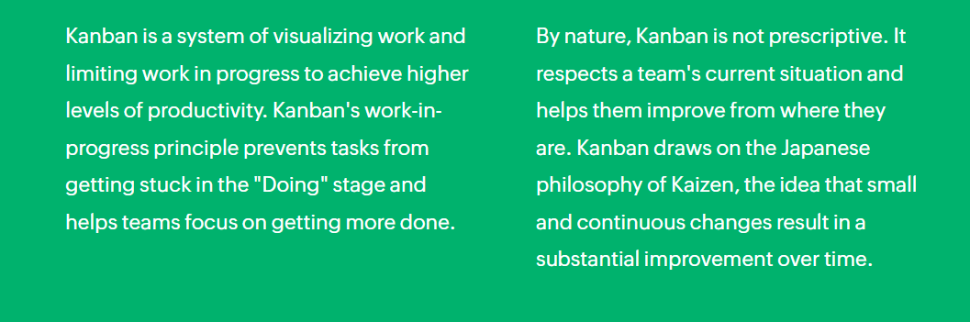
kanban

Slide 33
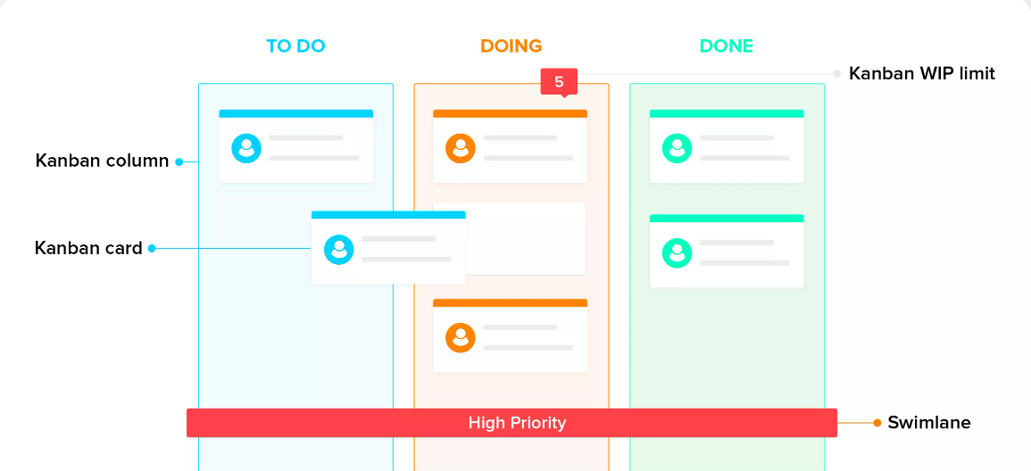
Kanban board

Slide 34
Sprint terminologies
Burn-down Chart: a chart which shows the amount of work which is thought to remain in a backlog. Time is shown on the horizontal axis and work remaining on the vertical axis. As time progresses and items are drawn from the backlog and completed, a plot line showing work remaining may be expected to fall. The amount of work may be assessed in any of several ways such as user story points or task hours. Work remaining in Sprint Backlogs and Product Backlogs may be communicated by means of a burn-down chart. See also: Burnup Chart
Burn-up Chart: a chart which shows the amount of work which has been completed. Time is shown on the horizontal axis and work completed on the vertical axis. As time progresses and items are drawn from the backlog and completed, a plot line showing the work done may be expected to rise. The amount of work may be assessed in any of several ways such as user story points or task hours. The amount of work considered to be in-scope may also be plotted as a line; the burn-up can be expected to approach this line as work is completed.

Slide 35
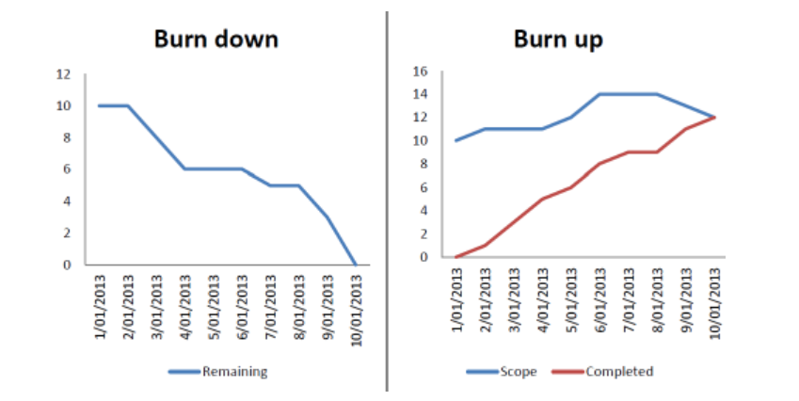
Burn down vs burn up chart

Slide 36
Sprint terminologies
Product Goal: The Product Goal describes a future state of the product which can serve as a target for the Scrum Team to plan against. The Product Goal is in the Product Backlog. The rest of the Product Backlog emerges to define “what” will fulfill the Product Goal.
Velocity: an optional, but often used, indication of the amount of Product Backlog turned into an Increment of product during a Sprint by a Scrum Team, tracked by the Developers for use within the Scrum Team.

Slide 37
Scrum Estimation
In Scrum Projects, Estimation is done by the entire team during Sprint Planning Meeting. The objective of the Estimation would be to consider the User Stories for the Sprint by Priority and by the Ability of the team to deliver during the Time Box of the Sprint.
Product Owner ensures that the prioritized User Stories are clear, can be subjected to estimation, and they are brought to the beginning of the Product Backlog
The size of the Product Increment is estimated in terms of User Story Points. Once the size is determined, the effort is estimated by means of the past data, i.e., effort per User Story Point called Productivity.

Slide 38
Scrum estimation techniques
The Scrum Estimation of User Stories is in terms of the degree of difficulty for each of the User Stories. To assess the degree of difficulty, a particular scale is used.
There are several types of scales that are used in Scrum Estimation. Following are some examples -
Numeric Sizing (1 through 10)
T-shirt Sizes (XS, S, M, L, XL XXL, XXXL)
Fibonacci Sequence (1, 2, 3, 5, 8, 13, 21, 34, etc.)

Slide 39
Scrum tools
Scrum Tools facilitate planning and tracking for Scrum projects. They provide a single place for managing the product backlog, sprint backlog, planning and tracking Sprints, displaying Burndown charts, conducting daily Scrum Meetings, and conducting Scrum Retrospectives.
There are many different types of Scrum Tools available. Some are free (open source), some are paid, and for some, you get a distilled version of the tool. However, to get all the features and scalability, you need to buy a full version.

Slide 40
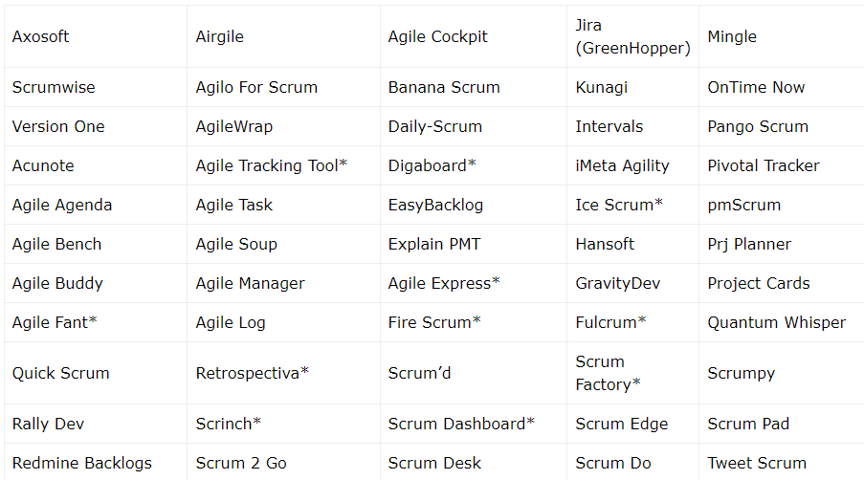
scrum tools

Slide 41
Scrum benefits
Scrum supports continuous collaboration among the customer, team members, and relevant stakeholders. Its time-boxed approach and continuous feedback from the product owner ensures working product with essential features all the times. Additionally, Scrum provides different benefits to the different roles in the project.
Benefits to Customer
The Sprints are of shorter duration and prioritized user stories are taken up at every sprint planning. It ensures that at every sprint delivery, the features as required by the customer immediately are included. Further, if a customer raises any change request, it will be absorbed in the current sprint, or included in the very next sprint. Thus, the development team quickly responds to the customer’s requirements very fast.

Slide 42
Scrum benefits
Benefits to Organization
Organization can focus on the effort required for development of the prioritized user stories and thus reduce overhead and rework. Due to the specific benefits of scrum to customer, increased efficiency of the development team, customer satisfaction and hence customer retention and customer references will be possible. It increases the market potential of the organization.
Benefits to Product Managers
Product Manager plays the role of Product Owner in the project. The responsibility of the product owner is to ensure customer satisfaction. Since Scrum facilitates quick responses, work prioritization, absorbing changes, product manager can easily ensure that the work is aligned to customer needs, which in turn ensures customer satisfaction.

Slide 43
Scrum benefits
Benefits to Project Managers
Project Manager plays the role of Scrum Master in the project. The collaborative nature of Scrum facilitates easy and concrete planning and tracking. The use of Burndown Charts to understand the work left, and the Daily Scrum meetings give the Project Manager awareness about the state of the project at all times. This awareness is essential to monitoring the project, and for catching and addressing issues quickly.
Benefits to Development Team
Due to the time-boxed nature of sprints and working product increment delivery at the end of every sprint, the development team becomes enthusiastic to see that their work is used immediately. The built in team collaboration makes the team enjoy the work they do. As the user stories for every sprint are based on customer priorities, team also understands that their work is valued.

Slide 44
Scrum certifications
Scrum certifications are offered by the Scrum Alliance. Following Certifications are being offered –
Certified ScrumMaster (CSM)
Certified Scrum Product Owner (CSPO)
Certified Scrum Practitioner (CSP)
Certified Scrum Coach (CSC)
Certified Scrum Trainer (CST)

Slide 45
Certified scrum master
Certified Scrum Master is the basic certification to become a member of Scrum Alliance, play Scrum Master’s Role, and be eligible for other certifications. The certification requires attendance of the CSM course. After that, the candidate gets an email specifying the details of the Scrum membership and the CSM online examination. After taking the examination, the candidate is given the Certified ScrumMaster (CSM) certification.

Slide 46
Certified scrum product owner
Certified Scrum Product Owner is the basic certification to become a member of Scrum Alliance, play Product Owner’s role, and be eligible for other certifications.

Slide 47
Certified scrum practitioner
Certified Scrum Practitioner is the certification for experienced ScrumMasters and Product Owners. The candidate should be a ScrumMaster or a Product Owner for at least one year. The candidate must submit an application containing a detailed description of what he or she has done in the specified role.
It is possible for a candidate to acquire the CSP certification immediately after the CSM certification or CSPO certification, provided the candidate is actively practicing the ScrumMaster’s role, or Product Owner’s role for the required duration.

Slide 48
Certified scrum coach
Certified Scrum Coach is the certification for those who focus on coaching. The certification requires that the candidate has coached Scrum Teams through their adoption and mastery of Scrum for at least 1500 hours in the past 5 years.

Slide 49
Certified scrum trainer
Certified Scrum Trainer is the certification for those who want to teach CSM or CSPO classes. Applicants must have either a CSM or CSPO, and should be a CSP for at least a year before applying.

Slide 50
Agile marketing
Agile marketing is an approach to marketing that utilizes the principles and practices of agile methodologies. This includes having self-organizing, cross-functional teams doing work in frequent iterations with continuous feedback. It requires a strategic vision, as well as short, medium, and long-term marketing planning.
Agile marketing values, as outlined by the Agile Marketing Manifesto, include:
Focusing on customer value and business outcomes over activity and outputs
Delivering value early and often over waiting for perfection
Learning through experiments and data over opinions and conventions
Cross-functional collaboration over silos and hierarchies

Slide 51

Characteristics of agile marketing

Slide 52
mcq
What is the primary goal of Agile?
a) Delivering projects on time b) Responding to change c) Reducing project costs d) Writing comprehensive documentation

Slide 53
mcq
. Which of the following is not an Agile methodology?
a) Scrum b) Waterfall c) Kanban d) XP (Extreme Programming)

Slide 54
mcq
Which of the following roles is not part of a Scrum team?
a) Scrum Master b) Product Owner c) Project Manager d) Development Team

Slide 55
mcq
What is a Product Backlog?
a) A list of defects b) A list of tasks for the next sprint c) A prioritized list of features and requirements d) A report of completed work

Slide 56
mcq
What is the typical duration of a Scrum Sprint?
a) 1 day b) 2 weeks to 1 month c) 6 months d) 1 year

Slide 57
mcq
Who is responsible for ensuring the team follows Scrum practices?
a) Product Owner b) Scrum Master c) Development Team d) Project Manager

Slide 58
mcq
What is a Sprint Retrospective?
a) A review of completed tasks b) A meeting to reflect on the sprint and improve future processes c) A planning session for the next sprint d) A meeting to demonstrate the product

Slide 59
mcq
What does the term "Increment" refer to in Scrum?
a) A timebox of one month b) A usable product delivered at the end of each sprint c) A list of new features d) A report on project progress

Slide 60
mcq
In Agile, what is "timeboxing"?
a) Limiting the scope of features b) Setting a fixed duration for events and activities c) Restricting resources for a project d) A project planning technique

Slide 61
mcq
What is the maximum time for a Daily Scrum (Stand-up)?
a) 15 minutes b) 30 minutes c) 1 hour d) 5 minutes

Slide 62
mcq
Which role is responsible for maximizing the value of the product?
a) Scrum Master b) Development Team c) Stakeholders d) Product Owner

Slide 63
mcq
What is a "burn-down chart" used for?
a) Measuring the progress of the team during a sprint b) Tracking defects in the product c) Planning tasks for the sprint d) Allocating team resources

Slide 64
MCQ
What is meant by "velocity" in Scrum?
a) Speed of software delivery b) Number of sprints completed c) Rate at which the team completes work d) Number of bugs fixed

Slide 65
mcq
What is meant by "velocity" in Scrum?
a) Speed of software delivery b) Number of sprints completed c) Rate at which the team completes work d) Number of bugs fixed

Slide 66
MCQ
What is "Definition of Done" (DoD) in Scrum?
a) A list of incomplete tasks b) Criteria that must be met before a product increment is considered complete c) A checklist for closing a project d) A description of finished documentation

Slide 67
MCQ
What does the Product Owner do in Scrum?
a) Manages the team’s work b) Manages the Product Backlog c) Estimates the tasks for the Sprint d) Conducts daily stand-up meetings

Slide 68
mcq
What does "Scrum" stand for?
a) Software Creation and Management b) It's not an acronym, it’s derived from rugby c) Sprint Creation and Management d) Systematic Collaborative Risk Management

Slide 69
mcq
How does the Scrum Master serve the development team?
a) Assigns tasks to individual team members b) Removes impediments and coaches the team c) Manages the Product Backlog d) Approves final increments

Slide 70
mcq
Which of the following is a benefit of using Agile?
a) Increased documentation b) Flexibility to change requirements c) A fixed project plan d) Reduced stakeholder involvement

Slide 71
MCQ
What is the role of stakeholders in Scrum?
a) Review the Sprint Backlog b) Participate in Sprint Planning c) Provide feedback during the Sprint Review d) Assign tasks to the Development Team

Slide 72
mcq
When can a Product Backlog be updated?
a) Only during Sprint Planning b) Anytime as necessary c) Only at the beginning of the project d) Only during the Sprint Review

Slide 73
mcq
Which event is timeboxed to ensure regular feedback?
a) Sprint Planning b) Daily Scrum c) Sprint Review d) Sprint Retrospective

Slide 74
mcq
In Scrum, who decides when an increment is "done"?
a) Scrum Master b) Product Owner c) Development Team d) Stakeholders

Slide 75
mcq
What is the outcome of a Sprint Planning session?
a) A product release b) A list of completed work c) A Sprint Backlog with tasks to be completed in the Sprint d) A report on team performance

Slide 76
mcq
What should happen if the Development Team realizes it cannot complete its work during a sprint?
a) Extend the Sprint duration b) Consult with the Product Owner and adjust the scope c) Cancel the Sprint d) Move the unfinished work to the next Sprint automatically

Slide 77
mcq
Which Agile practice focuses on continuous delivery of small, usable software increments?
a) Scrum b) Waterfall c) Pair programming d) Feature-Driven Development (FDD)

Slide 78
mcq
Which artifact gives a high-level overview of the project’s progress?
a) Sprint Backlog b) Burndown Chart c) Increment d) Gantt Chart

Slide 79
mcq
What does "Sprint Goal" represent?
a) A specific feature that must be completed b) The desired outcome of the Sprint c) A detailed list of tasks for the Sprint d) The estimated velocity for the Sprint

Slide 80
mcq
In Agile, how often should the Development Team deliver a product increment?
a) Every week b) At the end of each sprint c) Every month d) After every release

Slide 81
mcq
What is the key benefit of iterative development in Agile?
a) Ensures no bugs b) Enables frequent feedback and course correction c) Reduces project documentation d) Eliminates the need for a Product Backlog

